Slide 1
Lets have a game Guess the name of the Romanian paintings
Good luck!

Slide 2
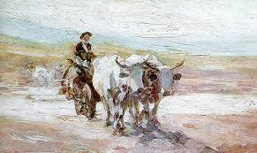
The correct answer is……
The man on bullock
Bullock cart

Slide 3
Bullock cart

Slide 4
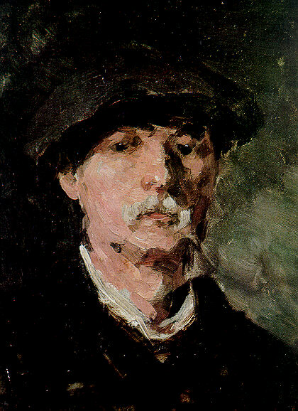
The correct answer is……
Myself
Self-portrait

Slide 5
Self-portrait

Slide 6
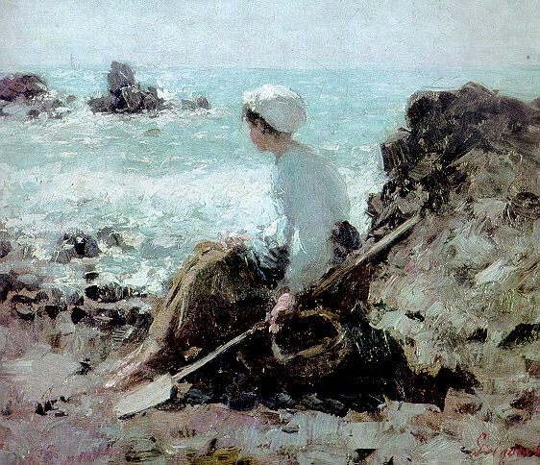
The correct answer is…
Fishermen from Grandville
fishermen

Slide 7
Fishermen from Grandville

Slide 8
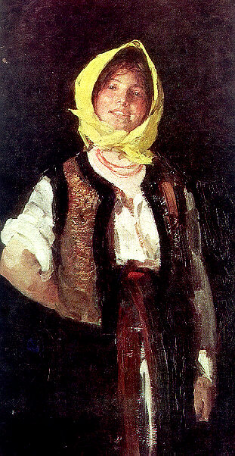
The correct answer is…
Cheerful peasant
A woman

Slide 9
Cheerful peasant

Slide 10
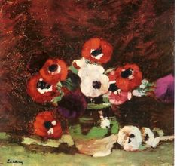
The correct answer is…
Anemona
Anemona flowers

Slide 11
Anemona flowers

Slide 12
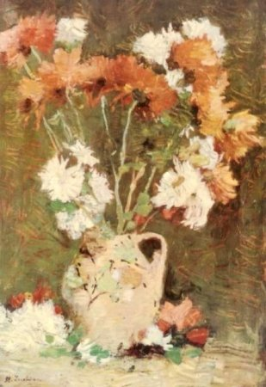
The correct answer is…
Chrysanthemus
Chrisanthemus flowers

Slide 13
Chrysanthemus

Slide 14
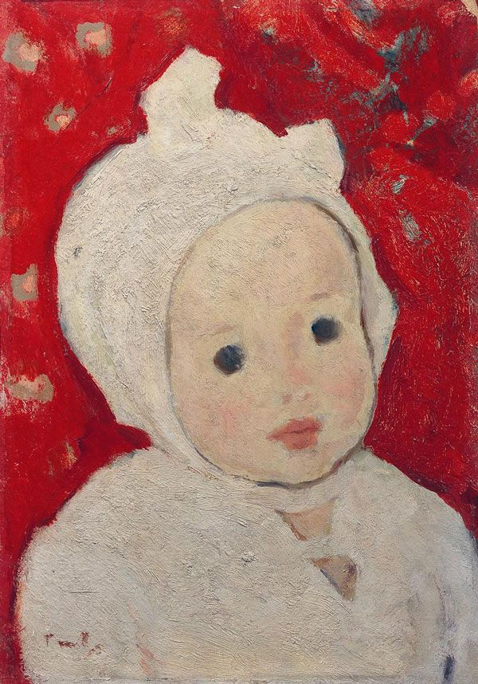
The correct answer is…
A child
Portrait of a child

Slide 15
Portrait of a child

Slide 16
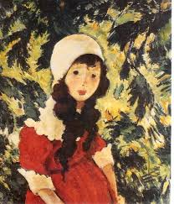
The correct answer is…
A girl in a forest
The Forest*s Daughter

Slide 17
The Forest*s Daughter

Slide 18
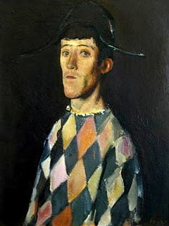
The correct answer is…

Slide 19
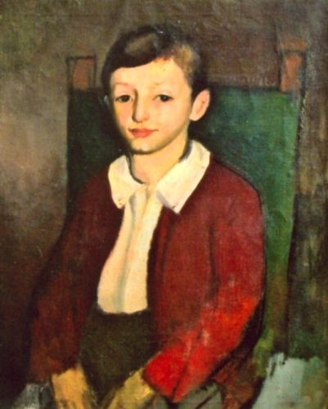
The correct answer is…
A boy
Portrait of a child

Slide 20
Portrait of a child

Slide 21
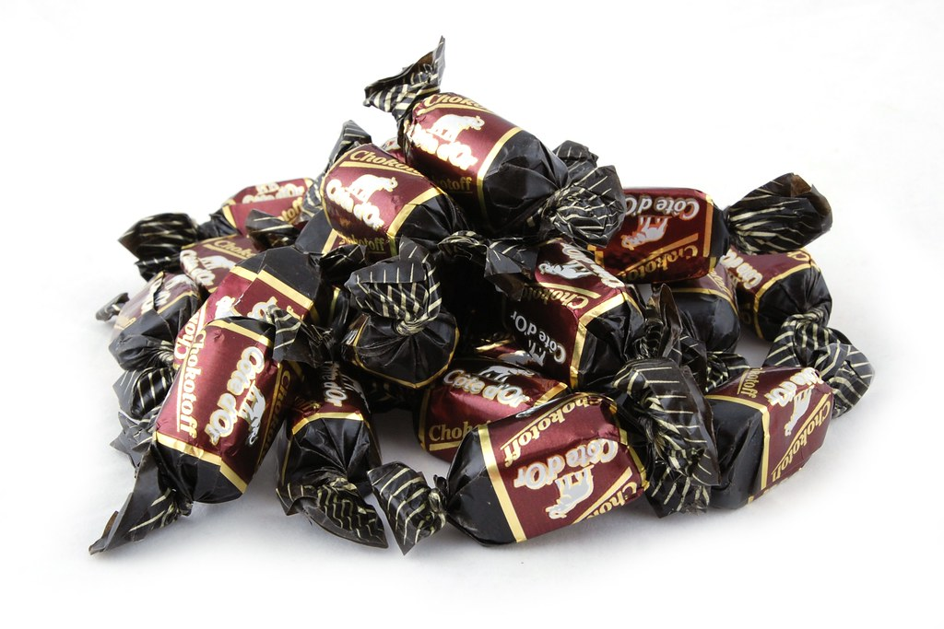
congratulations

